Slide 1

CN Project Final Presentation
Ⅵ^{th} SEM E&C
Home Security System with GSM using SPI,I2C and UART
DEPARTMENT OF ELECTRONICS AND COMMUNICATION ENGINEERING
MANIPAL INSTITUTE OF TECHNOLOGY
(A Constituent Institution of Manipal Academy of Higher Education)
MANIPAL – 576104, KARNATAKA, INDIA
MAY 2023

Slide 2
Submitted By:
Student Name: | Registration No.: | Roll No.:
Ananya Mannsingh | 200907124 | 19
Ark Verma | 200907126 | 20
Manas Choudhary | 200907154 | 22

Slide 3

Introduction:
A home security system provides peace of mind by
alerting homeowners when there is a break-in or suspicious
activity on their property. It also acts as a deterrent for
potential burglars, as they are less likely to target homes with
visible security systems.
Communication between different components is crucial
for proper functioning of home security systems. Three
common communication protocols used in these systems are
SPI, UART, and I2C. These protocols are used to transmit
data from sensors to the main control unit, which then
processes the information and triggers alarms or alerts if
necessary. Correct implementation of these protocols
ensures reliable and efficient communication within the
system, leading to better overall security.

Slide 4

Objective:
To implement a simple and affordable, but efficient home security alarm system. The project is designed for detecting intruders and informing the owner by sending an SMS.
To implement different protocols. (I2C, UART and SPI)
To implement sensors to get correct data and alert if an intruder is present.

Slide 5
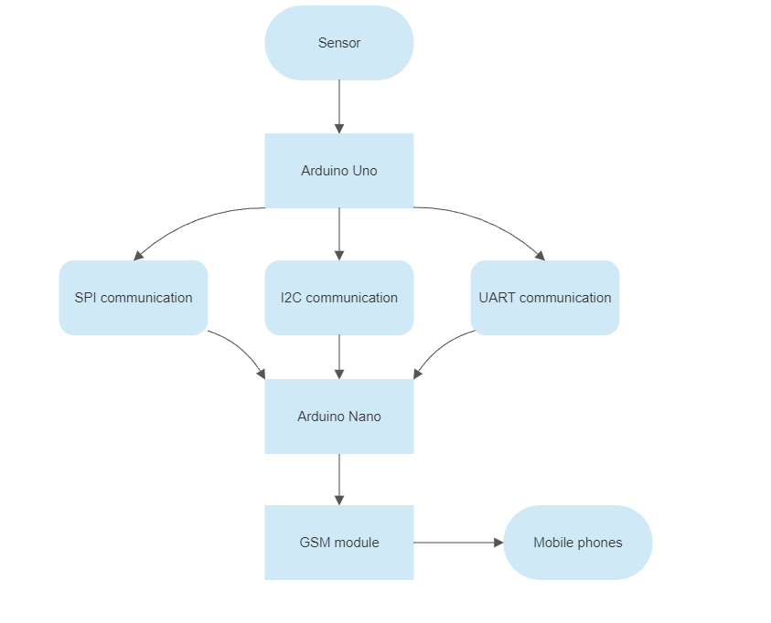
Methodology:
Flow Chart

Slide 6
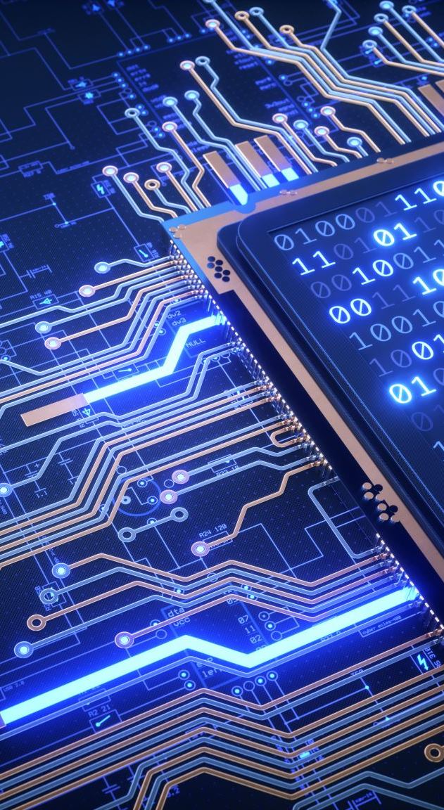
SPI Communication:
SPI (Serial Peripheral Interface) is a serial communication protocol. SPI has a full-duplex connection, which means that the data is sent and received simultaneously. That is a master can send data to a slave and a slave can send data to the master simultaneously. SPI is synchronous serial communication means the clock is required for communication purposes.
A SPI has a master/Slave communication by using four lines. A SPI can have only one master and can have multiple slaves. The selection of the peripheral device for communication is based on pulling a low on the particular peripheral select line by the controller device.

Slide 7

UART Communication
UART is the most common protocol that provides full-duplex serial communication. The purpose of UART chips is to convert incoming serial data to parallel data for the system to read and then revert the outgoing parallel data to serial data before exchanging it to other systems.

Slide 8
I2C Communication
Inter-integrated Circuit serial communication is a two-wire serial interface (TWI). It was designed for communication with lower-speed peripheral devices on the same board. The protocol is a master-slave protocol, where masters control the communication, and the slaves only respond. The protocol allows for multiple master and multiple slaves.
With I2C, you can connect multiple slaves to a single master (like SPI) and you can have multiple masters controlling single, or multiple slaves.
Introduction to I2C - Single Master Single Slave SDA (Serial Data) – The line for the master and slave to send and receive data. SCL (Serial Clock) – The line that carries the clock signal. I2C is a serial communication protocol, so data is transferred bit by bit along a single wire (the SDA line). Like SPI, I2C is synchronous, so the output of bits is synchronized to the sampling of bits by a clock signal shared between the master and the slave. The clock signal is always controlled by the master.

Slide 9
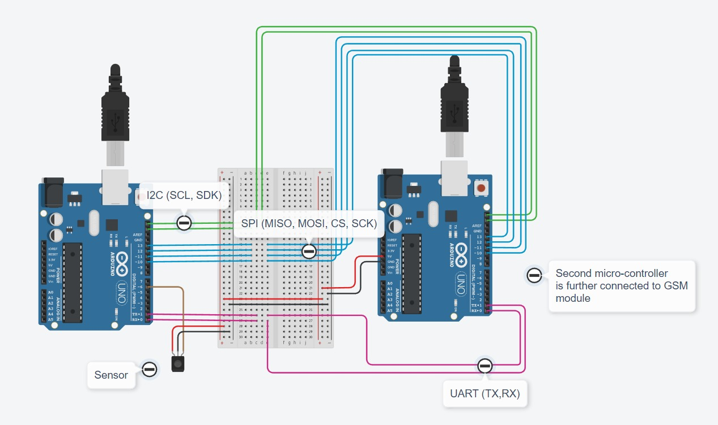
Circuit Diagram:

Slide 10
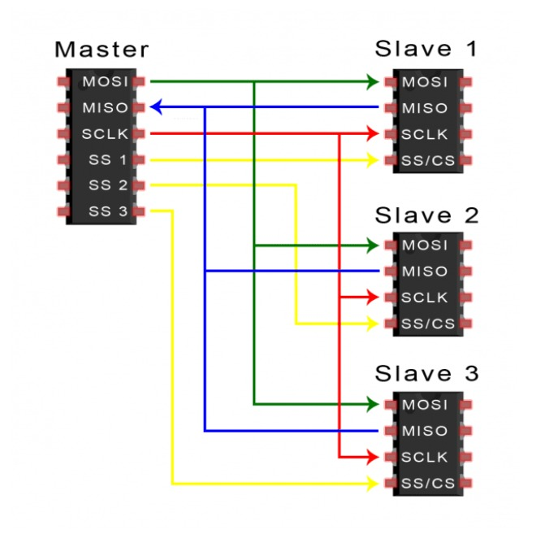
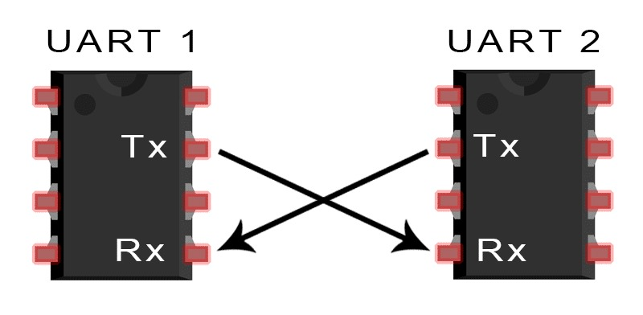
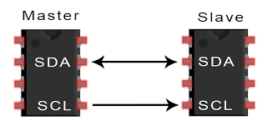
Connection between 2 devices for different protocols
Fig 1.: UART protocol
Fig 2.: I2C protocol
Fig 3.: SPI protocol

Slide 11
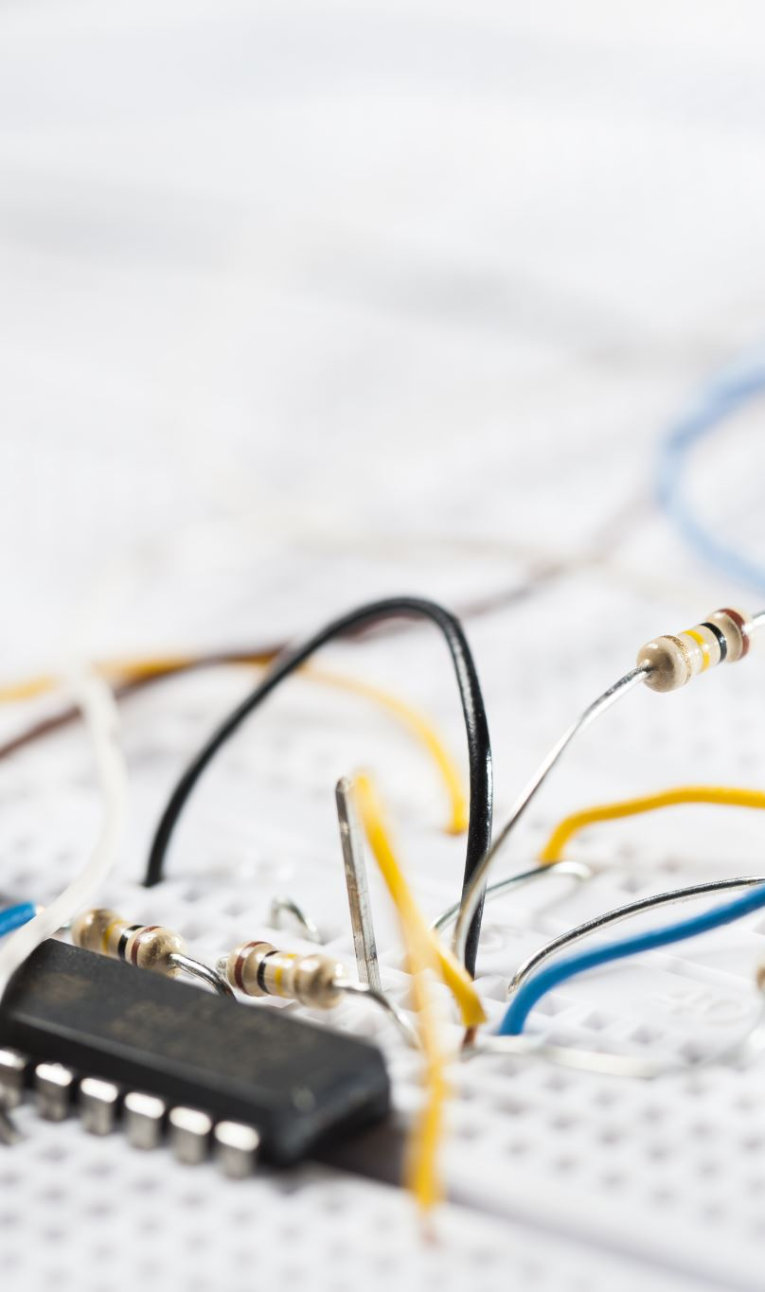
Methodology
The aim of the project is to alert the user about any intrusions using SPI, I2C and UART communication.
To achieve this, a sensor is used to detect the break in. The data thus gathered, is passed onto Arduino UNO allowing us to communicate using either SPI, I2C or UART protocol with connections as listed in the connection diagrams.
The data is then received by Arduino Nano, which communicates with GSM module through UART and depending on whether intrusion has occurred, notifies the owner.

Slide 12

Methodology
Platforms used:
1)Tinkercad
2)Arduino IDE
3)Proteus

Slide 13
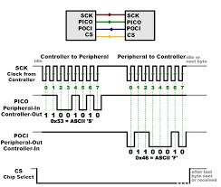
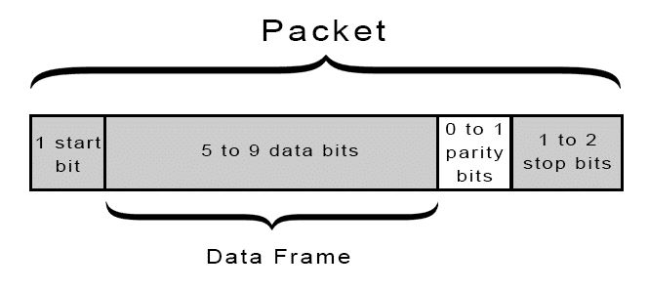
Frames of SPI and UART
Fig.2: UART
Fig.1: SPI

Slide 14
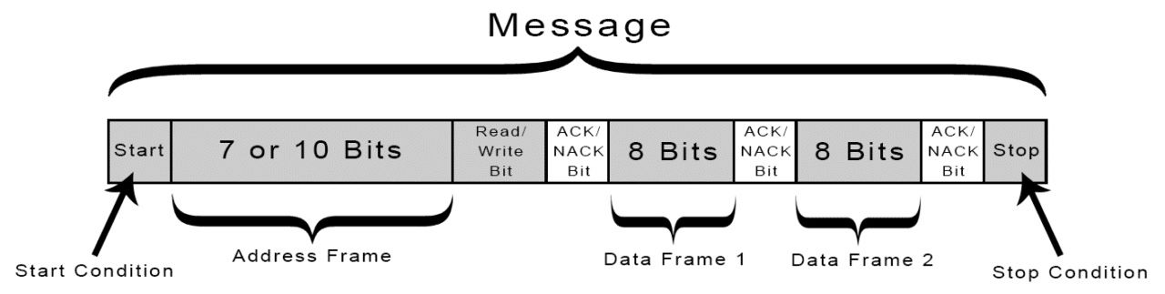
Frames of I2C
Fig 3.: I2C

Slide 15
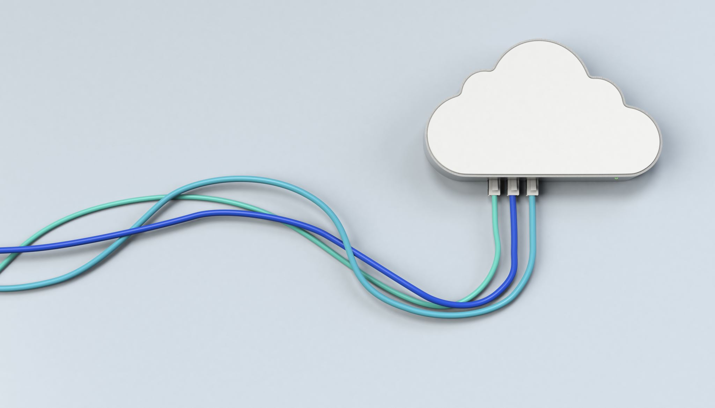
Comparing SPI, I2C and UART Communication
All three protocols use serial communication, which means that data is transferred one bit at a time.
All three protocols are limited to short-distance communication.
Data Rate: UART transfers serial data between the devices at lower data rates than SPI. The data rate of the UART devices communicating with each other must be equal due to the asynchronous type of communication. Maximum data rates are typically in the order of 230 kbps to 460 kbps in UART communication. The data rate is usually around 10 Mbps to 20 Mbps in an SPI communication bus. Whereas in I2C the data rate depends on mode of use: In standard mode, the maximum data rate is 100 kbit/s . In fast mode, the maximum data rate is 400 kbit/s, and in fast mode plus, the maximum data rate is 1 Mbit/s. There is also a high-speed mode that supports a maximum data rate of 3.4 Mbit/s.

Slide 16

Considering I2C vs UART vs. SPI speed, the fastest communication protocol for sending data over short distances from the two protocols is SPI, followed by I2C. The high-speed signals of an SPI interface limit its data transfer only over short distances. To send data over further distances, you must lower the clock speed and incorporate specialized driver chips.
Number of pins:
UARTs and I2C only require two pins, whereas SPI devices require at least four. This means that if pins/traces are sparse when constructing a system, SPI may not be the best option.
Number of devices that can be connected:
UART is practically confined to 1 to 1 communication because it only uses Tx and Rx for outbound communication. SPI and I2C, on the other hand, can use its master/slave paradigm to allow for an excessive number of communications.

Slide 17
GSM module
The SIM800L GSM/GPRS module is a miniature GSM modem that can be used in a variety projects. This module can do almost anything a normal cell phone can do, such as sending SMS messages, making phone calls, connecting to the Internet via GPRS, and much more.
In our project we will be implementing this to send messages of intrusion to the user
GSM is a mobile communication modem; it stands for global system for mobile communication (GSM). It is a widely used mobile communication system in the world. GSM is an open and digital cellular technology used for transmitting mobile voice and data services operate at the 850MHz, 900MHz, 1800MHz, and 1900MHz frequency bands.
GSM technology was developed as a digital system using the time division multiple access (TDMA) technique for communication purposes. A GSM digitizes and reduces the data, then sends it down through a channel with two different streams of client data, each in its own particular time slot. The digital system can carry 64 kbps to 120 Mbps of data rates.

Slide 18
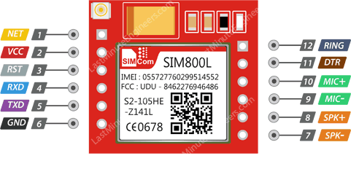
GSM pin module:

Slide 19

Software Details:

Slide 20
Complete code

Slide 21
Outcome:
Communication is perfectly established using SPI, I2C and UART protocols.
Intrusion alert message is successfully sent via the GSM module to the user.
Among the three protocols used, we find that SPI is the best followed by I2C and then UART.

Slide 22

References
https://www.circuitbasics.com/how-to-set-up-spi-communication-for-arduino/
https://www.tinkercad.com/things/if30J2KWLXV-epic-allis-albar/editel?sharecode=rUSPIOGsu8L8qkv84EQgNrV_rsHhjIXQ_oKl8f6cELw
https://lastminuteengineers.com/sim800l-gsm-module-arduino-tutorial/#:~:text=Now%20that%20you%20are%20familiar,the%20module%20via%20software%20UART

